Slide 1
Application of Double Exponential Jump Diffusion for Option Pricing
Shu Wang,
Dashan Xue,
Yizhou Huang,
Dan Zhu,
Kun Qian

Slide 2
01
02
03
Economic facts in stock market
Double Exponential Jump Diffusion model
Empirical analysis for DEJD
06
05
04
Conclusion
Empirical Analysis for MLE
Parameter estimation method - MLE
CONTENTS | 2
SECTION TITLE | 2

Slide 3
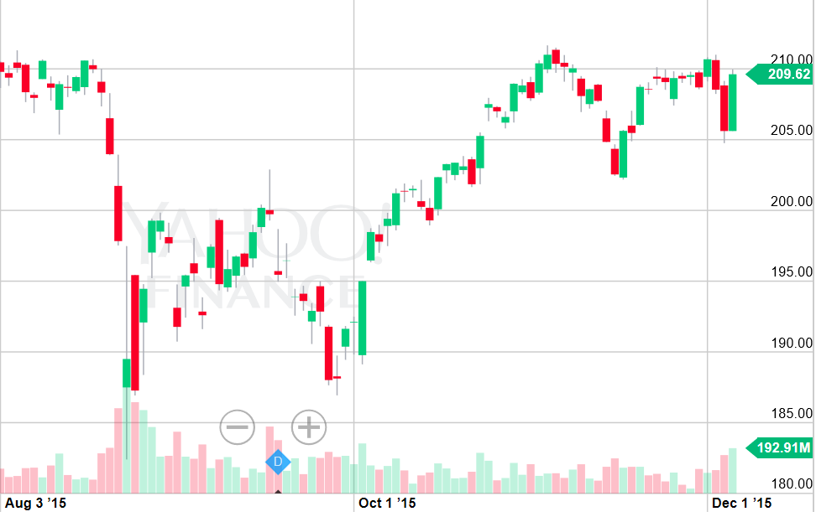
Economic Facts in Stock Market
finance.yahoo.com index: SPY interval: 08/03/2015-12/04/2015
ECONOMIC FACTS | 3

Slide 4
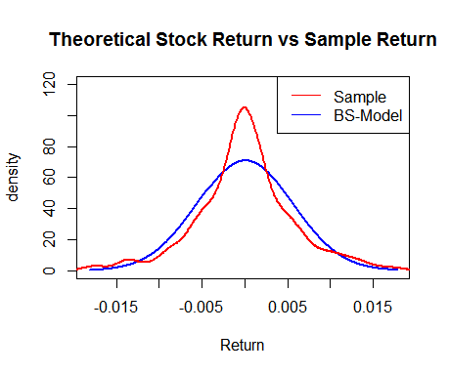
Asymmetric Leptokurtic feature
Excess Kurtosis: 1.22148 > 0
Skewness:
-0.0436 < 0
finance.yahoo.com index: SPY
01/02/2015-04/01/2016
ECONOMIC FACTS | 4

Slide 5
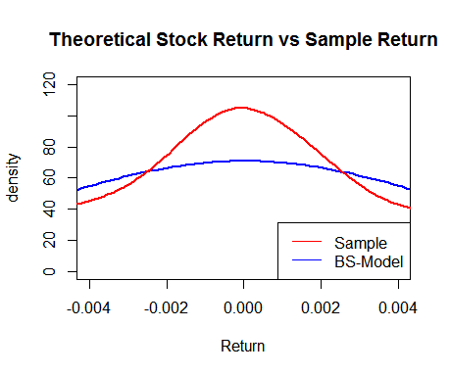
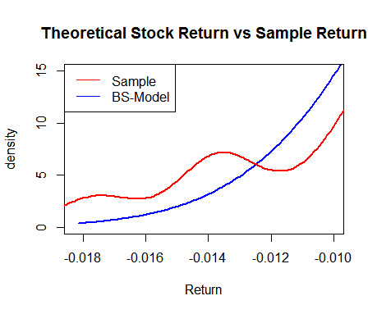
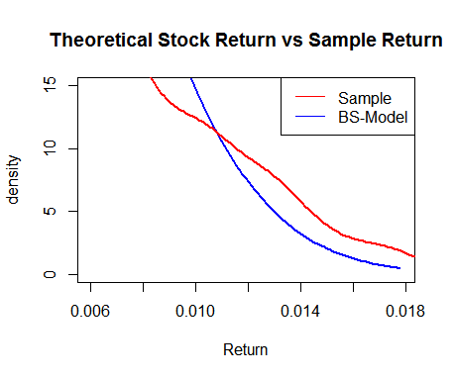
Behavior Pattern
underreaction
overreaction
ECONOMIC FACTS | 5

Slide 6
Alternative Models
Models Based on t-Distribution
- cannot be used in models with continuous compounding
The Normal Jump-Diffusion Model
- impossible to get analytical solutions for path-dependent options
- not asymmetric
ECONOMIC FACTS | 6

Slide 7
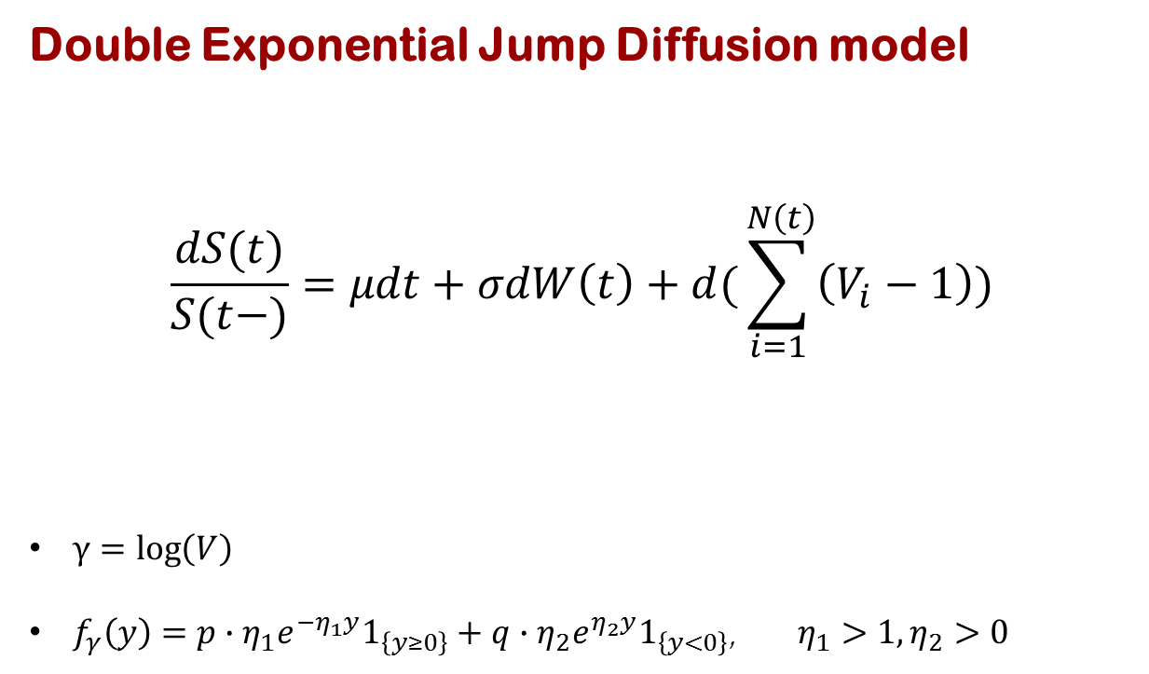
Double Exponential Jump Diffusion model
$$\frac{dS(t)}{S(t−)}=μdt+σdW\left(t\right)+d(\sum_{i=1}^{ N\left(t\right)}{\left(V_{i}−1\right)})$$
$γ=\log\left(V\right)$
$f_{γ}\left(y\right)=p∙η_{1}e^{−η_{1}y}1_{\left\{y≥0\right\}}+q∙η_{2}e^{η_{2}y}1_{\left\{y<0\right\}}$, $η_{1}>1, η_{2}>0$
Poisson process
Brownian motion term
jump term
DEJD MODEL | 7

Slide 8
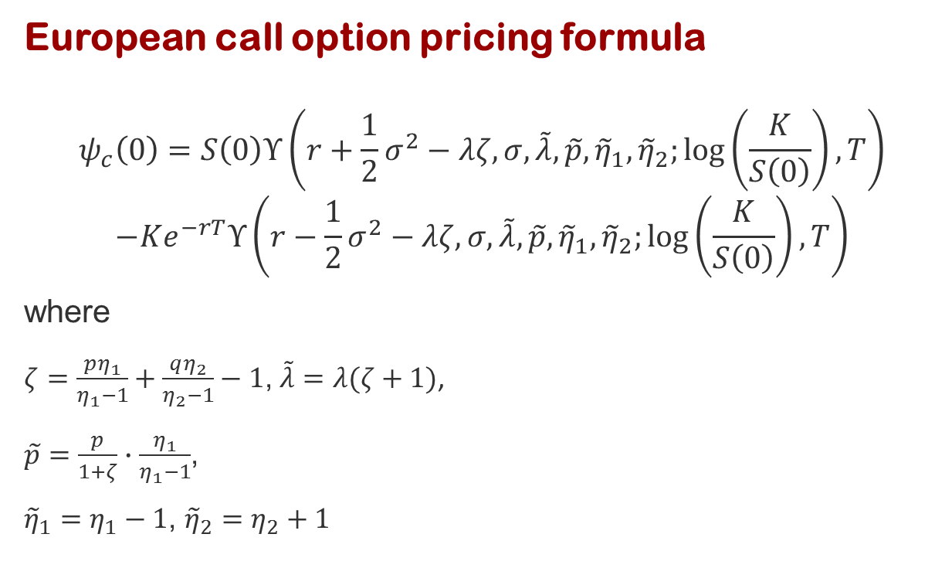
European call option pricing formula
$$ψ_{c}\left(0\right)=S\left(0\right)Υ\left(r+\frac{1}{2}σ^{2}−λζ,σ,\tilde{λ},\tilde{p},{\tilde{η}}_{1},{\tilde{η}}_{2};\log\left(\frac{K}{S\left(0\right)}\right),T\right)$$
$$−Ke^{−rT}Υ\left(r−\frac{1}{2}σ^{2}−λζ,σ,\tilde{λ},\tilde{p},{\tilde{η}}_{1},{\tilde{η}}_{2};\log\left(\frac{K}{S\left(0\right)}\right),T\right)$$
where
$ζ=\frac{pη_{1}}{η_{1}−1}+\frac{qη_{2}}{η_{2}−1}−1$, $\tilde{λ}=λ(ζ+1)$,
$\tilde{p}=\frac{p}{1+ζ}∙\frac{η_{1}}{η_{1}−1}$,
${\tilde{η}}_{1}=η_{1}−1$, ${\tilde{η}}_{2}=η_{2}+1$
DEJD MODEL | 8

Slide 9
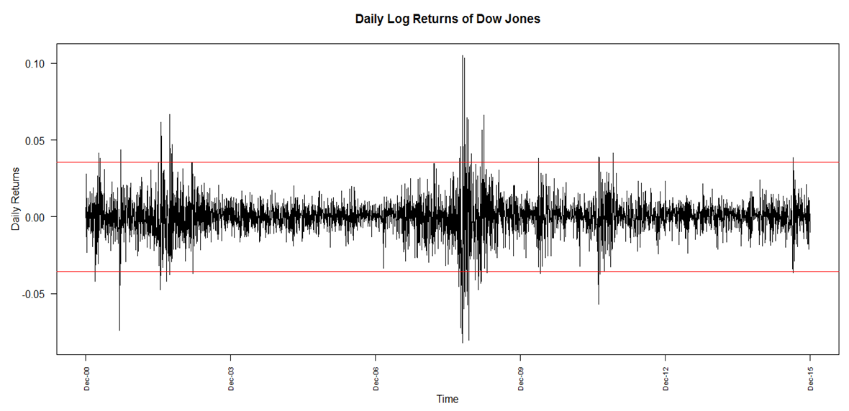
Daily log returns of Dow Jones
Daily Returns
Time
DEJD MODEL | 9

Slide 10
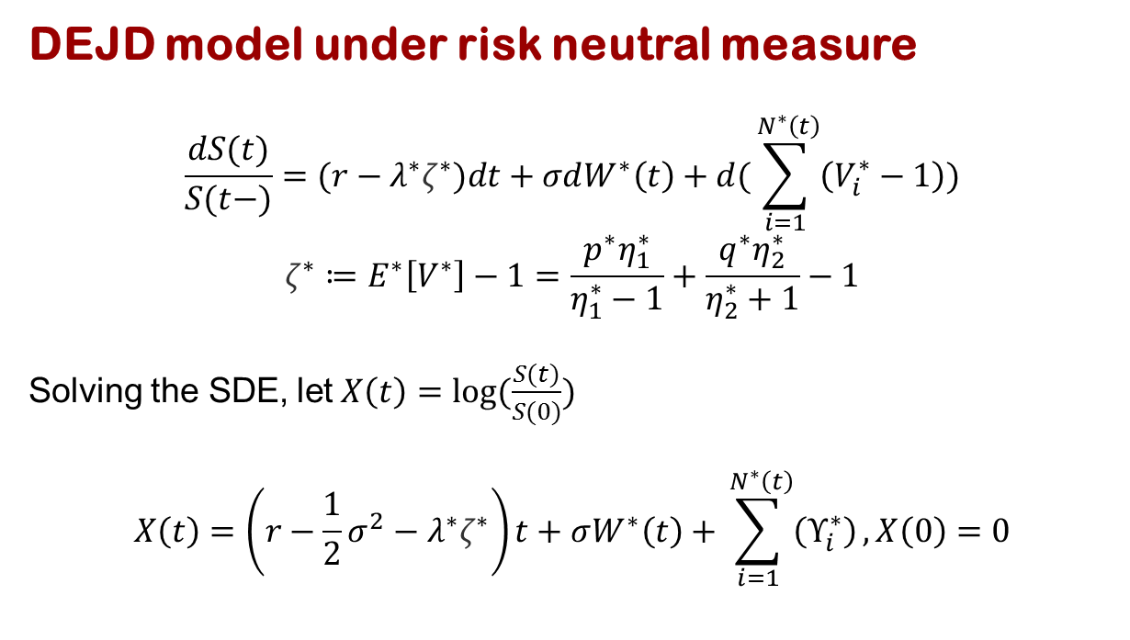
DEJD model under risk neutral measure
$$\frac{dS(t)}{S(t−)}=(r−λ^{∗}ζ^{∗})dt+σdW^{∗}\left(t\right)+d(\sum_{i=1}^{ N^{∗}\left(t\right)}{\left(V_{i}^{∗}−1\right)})$$
$$ζ^{∗}≔E^{∗}\left[V^{∗}\right]−1=\frac{p^{∗}η_{1}^{∗}}{η_{1}^{∗}−1}+\frac{q^{∗}η_{2}^{∗}}{η_{2}^{∗}+1}−1$$
Solving the SDE, let $X\left(t\right)=log⁡(\frac{S(t)}{S(0)})$
$$X\left(t\right)=\left(r−\frac{1}{2}σ^{2}−λ^{∗}ζ^{∗}\right)t+σW^{∗}\left(t\right)+\sum_{i=1}^{ N^{∗}\left(t\right)}{\left(Υ_{i}^{∗}\right)}, X\left(0\right)=0$$
DEJD MODEL | 10

Slide 11
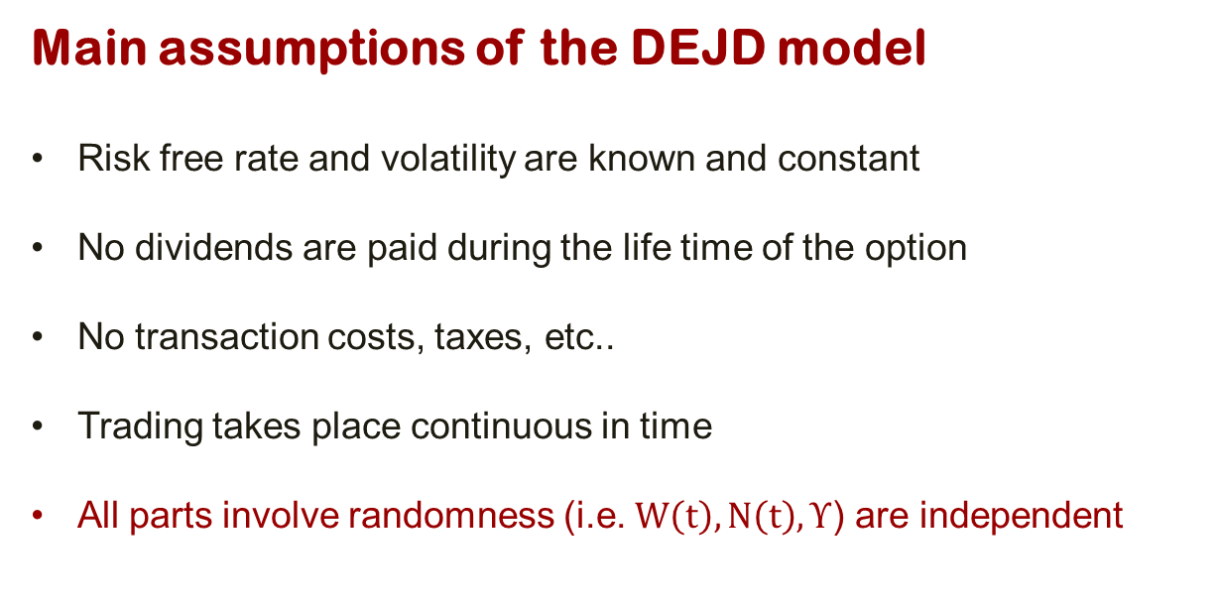
Main assumptions of the DEJD model
Risk free rate and volatility are known and constant
No dividends are paid during the life time of the option
No transaction costs, taxes, etc..
Trading takes place continuous in time
All parts involve randomness (i.e. $W\left(t\right), N\left(t\right), Υ$) are independent
DEJD MODEL | 11

Slide 12
Empirical Analysis
Replicate the existing DEJD model using given parameters
Estimate the parameters
Simulate option prices using parameters estimated from recent years
Empirical Analysis for DEJD | 12

Slide 13
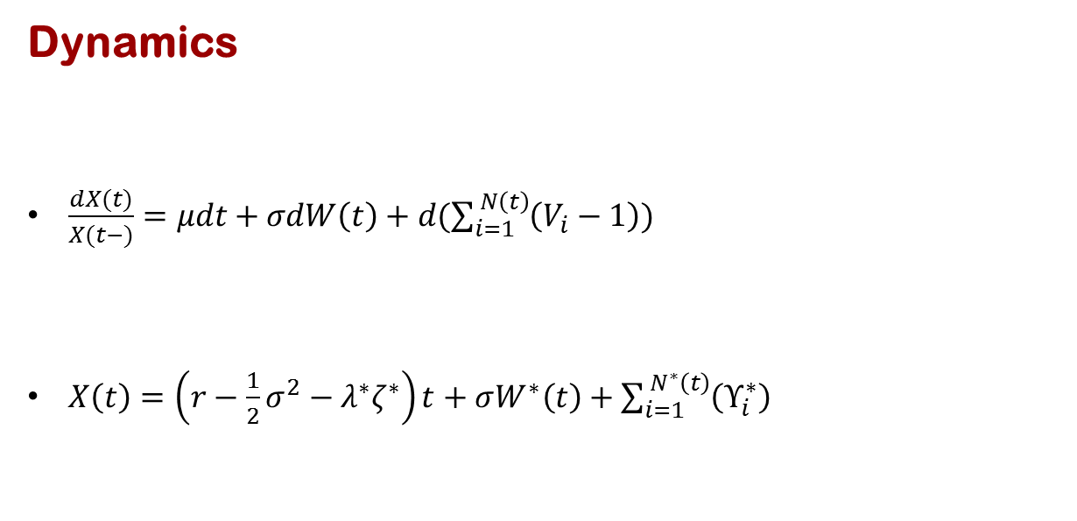
Dynamics
$\frac{dX(t)}{X(t−)}=μdt+σdW\left(t\right)+d(\sum_{i=1}^{ N\left(t\right)}{\left(V_{i}−1\right)})$
$X\left(t\right)=\left(r−\frac{1}{2}σ^{2}−λ^{∗}ζ^{∗}\right)t+σW^{∗}\left(t\right)+\sum_{i=1}^{ N^{∗}\left(t\right)}{\left(Υ_{i}^{∗}\right)}$
Empirical Analysis for DEJD | 13

Slide 14
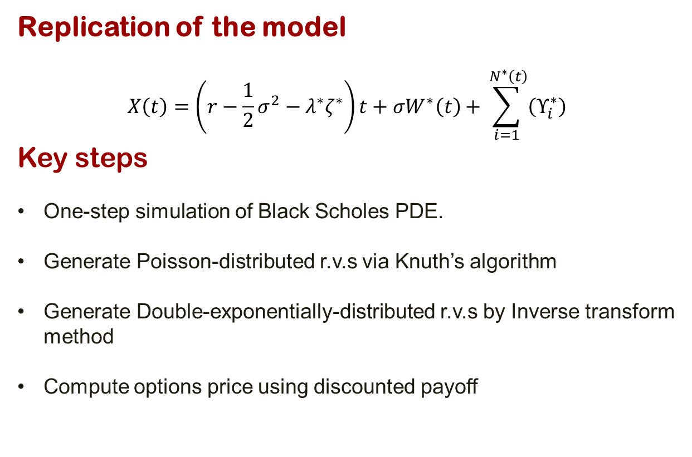
Replication of the model
$$X\left(t\right)=\left(r−\frac{1}{2}σ^{2}−λ^{∗}ζ^{∗}\right)t+σW^{∗}\left(t\right)+\sum_{i=1}^{ N^{∗}\left(t\right)}{\left(Υ_{i}^{∗}\right)}$$
Key steps
One-step simulation of Black Scholes PDE.
Generate Poisson-distributed r.v.s via Knuth’s algorithm
Generate Double-exponentially-distributed r.v.s by Inverse transform method
Compute options price using discounted payoff
Empirical Analysis for DEJD | 14

Slide 15
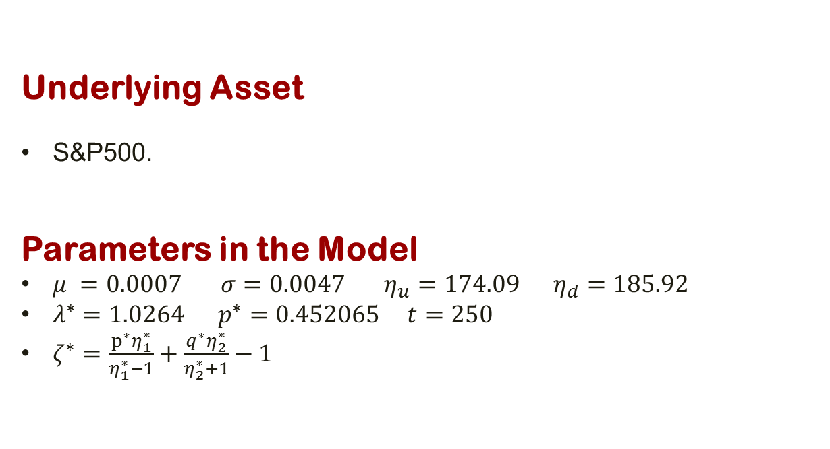
Underlying Asset
S&P500.
Parameters in the Model
$μ =0.0007 σ=0.0047 η_{u}=174.09 η_{d}=185.92$
$λ^{∗}=1.0264 p^{∗}=0.452065 t=250$
$ζ^{∗}=\frac{p^{∗}η_{1}^{∗}}{η_{1}^{∗}−1}+\frac{q^{∗}η_{2}^{∗}}{η_{2}^{∗}+1}−1$
Empirical Analysis for DEJD | 15

Slide 16
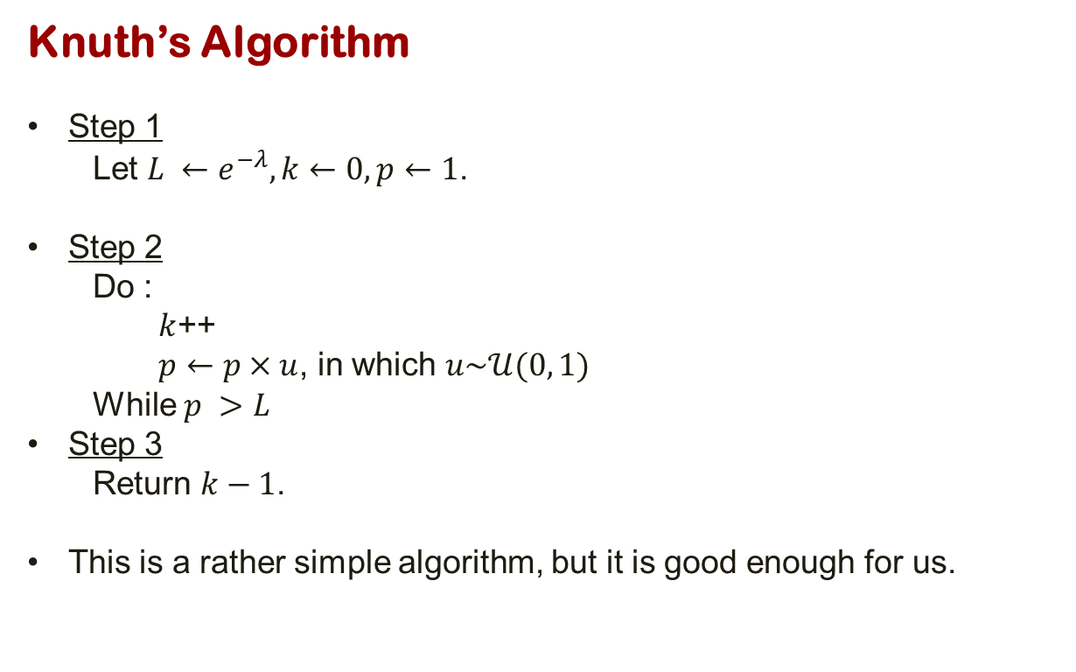
Knuth’s Algorithm
Step 1
Let $L ←e^{−λ}, k←0, p←1$.
Step 2
Do :
$k$++
$p←p×u$, in which $u\sim 𝒰(0, 1)$
While $p >L$
Step 3
Return $k−1$.
This is a rather simple algorithm, but it is good enough for us.
Empirical Analysis for DEJD | 16

Slide 17
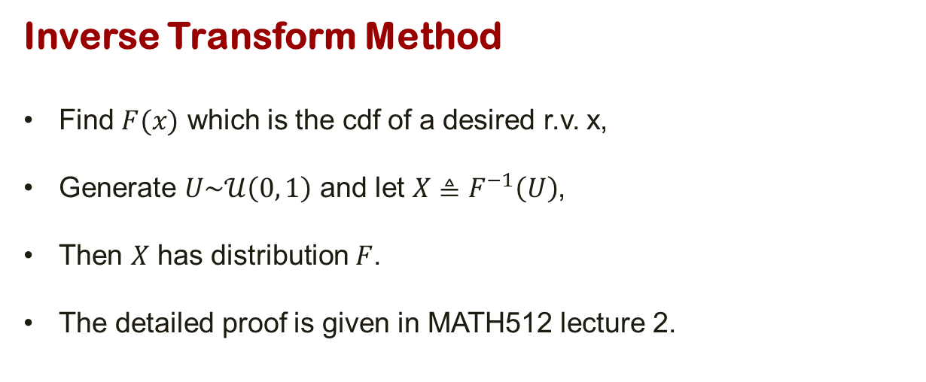
Inverse Transform Method
Find $F(x)$ which is the cdf of a desired r.v. x,
Generate $U\sim 𝒰\left(0, 1\right)$ and let $X≜F^{−1}\left(U\right)$,
Then $X$ has distribution $F$.
The detailed proof is given in MATH512 lecture 2.
Empirical Analysis for DEJD | 17

Slide 18
Calculation of options price
Instead of using Black Scholes Formula, directly find the average payoff, then discount it using rate of return of zero coupon bond.
Empirical Analysis for DEJD | 18

Slide 19
Errors
.
.
Variance
Bias
Accuracy of Parameters
Accuracy of Model
Parameter Estimation | 19
SECTION TITLE | 2

Slide 20
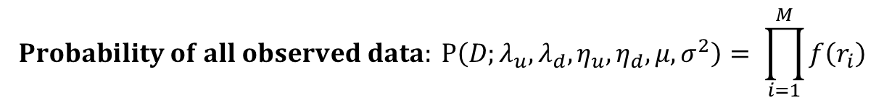
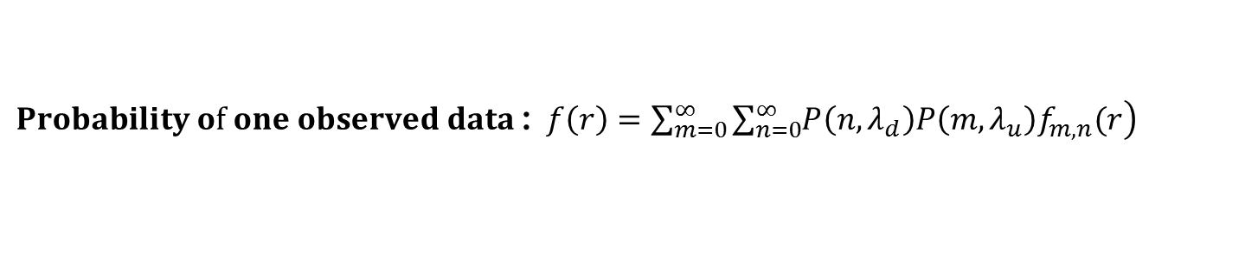

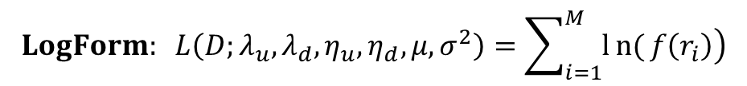
MLE: Density function of all observed data
$r_{i}=lnS\left(i\right)−lnS(i−1)$ is I.I.D.
$$Probability of all observed data: P\left(D;λ_{u},λ_{d},η_{u}, η_{d},μ,σ^{2}\right)= \prod_{i=1}^{M}{f\left(r_{i}\right)}$$
$$LogForm: L\left(D;λ_{u},λ_{d},η_{u}, η_{d},μ,σ^{2}\right)=\sum_{i=1}^{M}{\left.ln{(}f\left(r_{i}\right)\right)}$$
Nees to Maximize $L\left(D;λ_{u},λ_{d},η_{u}, η_{d},μ,σ^{2}\right)$ !
$Probability of one observed data$: $f\left(r\right)=\sum_{m=0}^{∞}{\sum_{n=0}^{∞}{\left.P\left(n,λ_{d}\right)P\left(m,λ_{u}\right)f_{m,n}(r\right)}}$
Parameter Estimation | 20

Slide 21
MLE: Mixture Model
$$Let P\left(n,λ\right)=\frac{e^{−λ}λ^{n}}{n!}$$
$$f\left(r_{i}\right)=e^{−\left(λ_{u}+λ_{d}\right)}f_{0,0}\left(r_{i}\right)$$
Probability of NO jump occurring
$$+e^{−λ_{u}}\sum_{n=1}^{∞}{P\left(n,λ_{d}\right)f_{0,n}\left(r_{i}\right)}$$
Probability of only DOWN jumps occurring
$$+e^{−λ_{d}}\sum_{m=1}^{∞}{P\left(m,λ_{u}\right)f_{m,0}\left(r_{i}\right)}$$
Probability of only UP jumps occurring
$$+\sum_{m=1}^{∞}{\sum_{n=1}^{∞}{P\left(n,λ_{d}\right)P\left(m,λ_{u}\right)f_{m,n}(r_{i})}}$$
Probability of both UP jump and DOWN
jump occurring
Parameter Estimation | 21

Slide 22
MLE: Complexity and Challenges
Complexity 1: Loglikelihood can’t be reduced into linear form
$$L\left(D;λ_{u},λ_{d},η_{u}, η_{d},μ,σ^{2}\right)=\sum_{i=1}^{M}{\left.ln{(}f\left(r_{i}\right)\right)};$$
$f(r_{i})=\sum_{m=0}^{∞}{\sum_{n=0}^{∞}{\left.P\left(n,λ_{d}\right)P\left(m,λ_{u}\right)f_{m,n}(r_{i}\right)}}$;
Complexity 2: $f_{m,n}\left(r\right) has very complex form$
$$f_{m,n}\left(r\right)=\frac{η_{μ}^{m}η_{d}^{n}}{\begin{aligned}&\left(m−1\right)!\left(n−1\right)!\sqrt{2πsσ} \\ &\end{aligned}}$$
$$\int_{−∞}^{∞}{\left(\int_{−∞}^{0^t}{\begin{aligned}{\left(−x\right)}^{n−1}{\left(t−x\right)}^{m−1}e^{{\left(η\right.}_{μ}+η_{d})x}dx ) \\ \end{aligned}}\right.}$$
$$∗e^{−η_{μ}t}e^{−\frac{1}{2σ^{2}s}{\left(r−t−μs+0.5σ^{2}s\right)}^{2}}dt$$
Challenges: numerical difficulty
Hard to numerically calculate derivatives of $L\left(D;λ_{u},λ_{d},η_{u}, η_{d},μ,σ^{2}\right)$
Hard to numerically calculate the infinite integration in $f_{m,n}\left(r\right)$
Parameter Estimation | 22

Slide 23
MLE: Influence of Challenges and Solutions
Influence
Solution: avoid derivatives
Solution: transform the integration
Can’t use Gradient Method
The Complexity of the Model leads to great difficulty when calculating derivatives (first order, second order) .
BOBYQA Method
Bound Optimization By Quadratic Approximation (BOBYQA) can solve bound constrained optimization problems without derivatives
Change variables in integration
Different from traditional truncation method, our group develped the variable changing method to transform the infinite integration into piecewise finite integration, which is easier for computing.
Parameter Estimation | 23

Slide 24
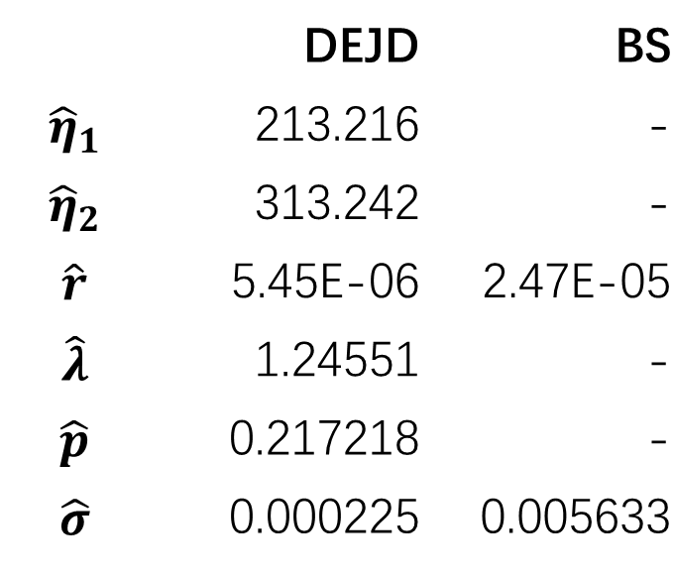
Conclusion – MLE
Estimated from S&P500 daily return, 01/01/2015 – 04/01/2016
 | DEJD | BS
$${\hat{η}}_{1}$$ | 213.216 | -
$${\hat{η}}_{2}$$ | 313.242 | -
$$\hat{r}$$ | 5.45E-06 | 2.47E-05
$$\hat{λ}$$ | 1.24551 | -
$$\hat{p}$$ | 0.217218 | -
$$\hat{σ}$$ | 0.000225 | 0.005633
CONCLUSION | 24
Notes:
Lambda: rate for Poisson Process
Lambda increases -> jump freq. increases
P: down jump ratio
P < ½: down jump occurs more frequently
BS: from sample mean / variance
Sigma for DEJD < sigma for BS:
part of the volatility is explained by jump term

Slide 25
Conclusion – Option Pricing
Table 6-1. European call option price estimated by DEJD model.
T | K | lambda
 |  | 0.6 | 0.9 | 1.2
250 | 90 | 0.114167 | 0.249643 | 0.489992
 | 100 | 2.381750 | 2.956990 | 3.271850
 | 110 | 9.879620 | 10.196600 | 10.610600
500 | 90 | 0.364972 | 0.842972 | 1.162280
 | 100 | 3.353250 | 4.273380 | 5.038110
 | 110 | 10.308200 | 11.016800 | 11.242500
CONCLUSION | 25
Notes:
C increases as:
K increases,
lambda increases, and
Maturity time increases
Color of each cell indicates price from high to low

Slide 26
Conclusion – Option Pricing
Table 6-2. European put option price estimated by DEJD model.
T | K | lambda
 |  | 0.6 | 0.9 | 1.2
250 | 90 | 10.046000 | 10.295700 | 10.492900
 | 100 | 2.588240 | 2.949290 | 3.508130
 | 110 | 0.222815 | 0.366591 | 0.606458
500 | 90 | 10.793500 | 10.914700 | 11.079100
 | 100 | 3.599010 | 4.241760 | 4.617090
 | 110 | 0.618856 | 1.273220 | 1.620740
CONCLUSION | 26
Notes:
C increases as:
K decreases,
lambda increases, and
Maturity time increases

Slide 27

Conclusion – Option Pricing
CONCLUSION | 27
Notes:
Relation K & C/P - clear
For both types of options,
Price increases as lambda increases
Recall: lambda is the frequency

Slide 28
Conclusion – Option Pricing
CONCLUSION | 28
Notes:
Option price from DEJD model is quite near
from prices from Black-Scholes model

Slide 29
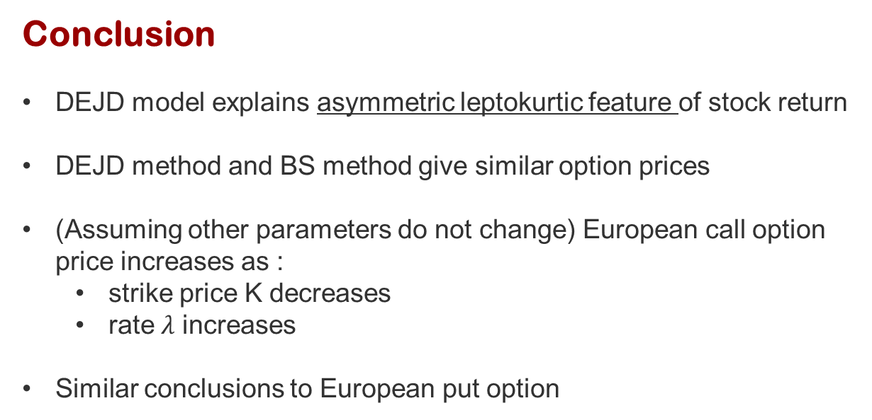
Conclusion
DEJD model explains asymmetric leptokurtic feature of stock return
DEJD method and BS method give similar option prices
(Assuming other parameters do not change) European call option price increases as :
strike price K decreases
rate$λ$ increases
Similar conclusions to European put option
CONCLUSION | 29
Notes:
1.
2. similar
Surprising: since the random walk assum. NOT fit the reality
Thus, BS model is still valuable for Vanilla option pricing
(Some papers have pointed out some differences for Lookback options)
3. Larger lambda leads to a larger price:
Explained by the jump term

Slide 30
Thanks for listening.
Feel free to ask questions.

